Slide 1
SQL Server 2019

Slide 2


Slide 3


SQL Server 2019
Andrea Benedetti
Microsoft | @anBenedetti

Slide 4
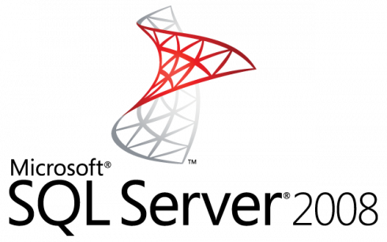
Winter is coming…
July 9, 2019

Slide 5




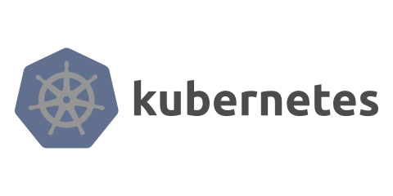
Announcing
SQL Server 2019
Preview

Slide 6

SQL Server 2019
Industry-leading performance and security, with intelligence over all your data
Intelligence over any data
Choice of platform and language
Industry-leading performance
Most secure over the last 8 years⁵
Insights in minutes and rich reports
+
#1 OLTP performance¹
#1 DW performance on 1TB², 10TB³, and 30TB⁴
Intelligent Query Processing
AI and Machine Learning over all data with the power of SQL and Spark
T-SQL
Java
C/C++
PHP
Node.js
C#/VB.NET
Python
Ruby
The best of Power BI and SQL Server Reporting Services with Power BI Report Server
In-memory across all workloads
Most consistent data platform
Private cloud
1/10th the cost of Oracle
Public cloud
All TPC Claims as of 1/19/2018.
¹ http://www.tpc.org/4081; ² http://www.tpc.org/3331; ³ http://www.tpc.org/3326; ⁴ http://www.tpc.org/3321; ⁵ National Institute of Standards and Technology Comprehensive Vulnerability Database

Slide 7
SQL Server is the platform of choice
Windows
Linux
Support for RedHat Enterprise Linux (RHEL), Ubuntu, and SUSE Enterprise Linux (SLES)
Linux and Windows Docker containers
Windows Server / Windows 10
Package-based installation: Yum Install, Apt-Get, and Zypper
Database and tools compatibility on all platforms
Docker containers and Kubernetes

Slide 8
In 2016
In 2025
16.1 ZBs of data was generated
163 ZBs of data will be generated
*IDC White Paper, Data Age 2025: The Evolution of Data to Life-Critical

Slide 9
Organizations that transform data into insights outperform the competition
The task of generating insights from ever-increasing data is tough
Barriers to insights are barriers to success
Nearly double
operating margin
$100M in additional
operating income

Slide 10
SQL Server 2017
Industry-leading Performance and Security with Intelligence over all your data
Intelligence over all data drives innovation
Integrating all data
Managing all data
Analyzing all data
Private cloud
Simplified management and analysis through a unified deployment, governance, and tooling model
Public cloud
In-memory across all workloads
Most consistent data platform
1/10th the cost of Oracle

Slide 11
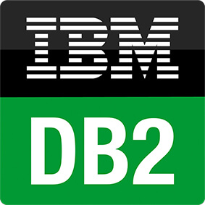








SQL Server is the hub for integrating data
Easily combine across relational and non-relational data stores
Analytics
T-SQL
Apps
SQL Server
PolyBase external tables
ODBC
NoSQL
Relational databases
Big Data
Excel
Cosmos DB

Slide 12

Scale Big Data on demand
Custom apps
BI
Analytics
SQL
SQL Server master instance
SQL Server can now read directly from HDFS files
Elastically scale compute and storage using HDFS-based storage pools with SQL Server and Spark built in
Apps, BI, and analytics access Big Data through the
SQL Server master instance
Spark
SQL Server
Spark
SQL Server
Spark
SQL Server
HDFS Data Node
HDFS Data Node
HDFS Data Node
Kubernetes pod
Node
Node
Node
Persistent storage

Slide 13
Build more intelligent apps with ML Services built into SQL Server
Access relational and non-relational data using familiar T-SQL commands and development frameworks
Enrich apps with data from other sources like Oracle database, Mongo DB
Build intelligent applications with access to unstructured, high volume, and high velocity data
Train R and Python models against Big Data stored in Hadoop and score your application data without ever leaving SQL Server
Apply easy to use tools like Azure Data Studio and Visual Studio Code
Django framework
SQL Server master instance
Storage pool
Spark
SQL Server
Spark
SQL Server
Spark
SQL Server
HDFS Data Node
HDFS Data Node
HDFS Data Node

Slide 14
Intelligence over all data drives innovation
SQL Server 2019 big data & analytics
Data virtualization
Managed SQL Server, Spark, and data lake
Complete AI platform
Admin portal and management services
Integrated AD-based security
Analytics
T-SQL
Apps
REST API containers for models
SQL Server External Tables
SQL Server
Spark
SQL Server
ML Services
Spark & Spark ML
Compute pools and data pools
Scalable, shared storage (HDFS)
Open database connectivity
NoSQL
Relational databases
HDFS
External data sources
HDFS
Combine data from many sources without moving or replicating it
Scale out compute and caching to boost performance
Store high volume data in a data lake and access it easily using either SQL or Spark
Management services, admin portal, and integrated security make it all easy to manage
Easily feed integrated data from many sources to your model training
Ingest and prep data and then train, store, and operationalize your models all in one system
Integrating all data
Managing all data
Analyzing all data

Slide 15
What’s in SQL Server on Linux
 |  | Windows | Linux
Editions | Developer, Express, Web, Standard, Enterprise |  | 
Services | Database Engine, Integration Services, SQL Server Agent |  | 
 | Analysis Services, Reporting Services, MDS, DQS | 
Mission critical performance and HADR | Maximum number of cores | Unlimited | Unlimited
 | Maximum memory utilized per instance | 24 TB | 12 TB
 | Maximum database size | 524 PB | 524 PB
 | Basic OLTP (Basic In-Memory OLTP, Basic operational analytics) |  | 
 | Advanced OLTP (Advanced In-Memory OLTP, Advanced operational analytics, adaptive query processing) |  | 
 | SQL Server Replication |  | 
 | Basic high availability (2-node single database failover, non-readable secondary) |  | 
 | Advanced HA (Always On - multi-node, multi-db failover, readable secondaries) |  | 
Security | Basic security (Basic auditing, Row-level security, Data masking, Always Encrypted, Active Directory Authentication) |  | 
 | Advanced security (Transparent Data Encryption) |  | 
Data warehousing | PolyBase |  | Planned
 | Basic data warehousing/data marts (Basic In-Memory ColumnStore, Partitioning, Compression) |  | 
 | Advanced data warehousing (Advanced In-Memory ColumnStore) |  | 
 | Advanced data integration (Fuzzy grouping and look ups) |  | 
Tools | Windows ecosystem: Full-fidelity Management & Dev Tool (SSMS & SSDT), command line tools |  | 
 | Linux/OSX/Windows ecosystem: Dev tools (VS Code), DB Admin GUI tool, command line tools |  | 
Developer | Programmability (T-SQL, CLR, Data Types, JSON, Graph) |  | 
 | Distributed Transactions |  | 
 | Machine Learning Services |  | 
NEW
NEW
NEW

Slide 16
TSQL Demo

Slide 17
Table variable deferred compilation
Table variables have a bit of a bad reputation, mostly because of estimates
SQL Server → estimate that only one row will ever be present in the table variable
Typical workaround = OPTION (RECOMPILE)
But:
code change
wasteful to recompile every single time (when row counts are usually the same)

Slide 18
Faster Functions
Scalar functions / multi-statement table-valued functions
…
notorious performance killers :-)

Slide 19
Batch mode over rowstore
SQL Server 2012 → tables with CI → performance batch mode
Improvements = batch processing rather than row-by-row
SQL Server 2019 will automatically choose batch mode in certain “sweet spot” cases, even when no columnstore index is present

Slide 20
Built-In Data Classification and Auditing
SSMS 17.5 → ability to classify data (sensitive info or compliance to various standards (HIPAA, SOX, PCI, and of course GDPR)
The wizard uses an algorithm to suggest columns it thinks are likely to cause compliance issues, but you can add your own, adjust its suggestions, and eliminate any columns from the list.
extended properties + SSMS-based report
Outside of the report → properties not highly visible
SQL Server 2019 → new command for metadata
ADD SENSITIVITY CLASSIFICATION
Info (no extended properties) automatically shows in audits in a new XML column called data_sensitivity_information

Slide 21
New function to retrieve page info
DBCC PAGE / DBCC IND → info about pages
Undocumented / unsupported commands ☺
Bad solutions (with more than one index or page)
A New DMF: sys.dm_db_page_info
All of the info on a page

Slide 22
Graph enhancements
A new edge constraint will allow you to dictate which nodes an edge can connect

Slide 23
Silent data truncation
…

